Slide 1
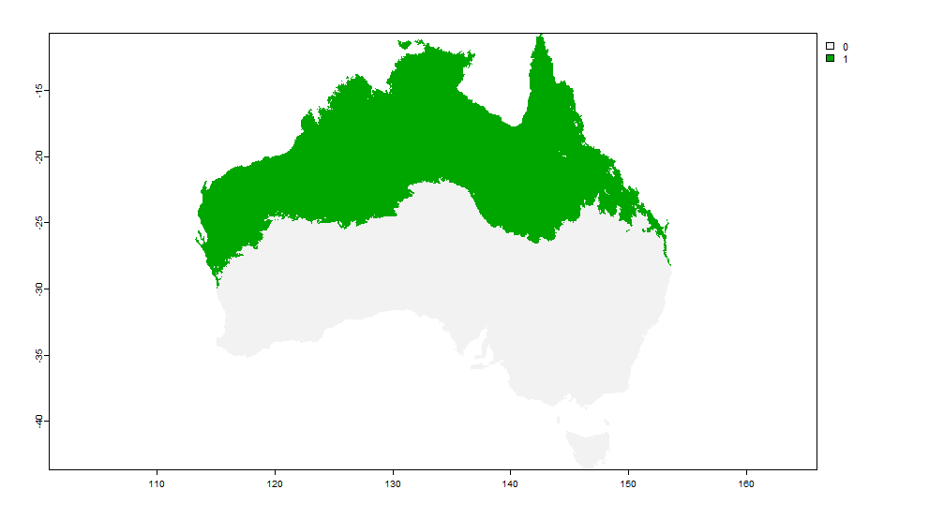
Today
City | Status
Sydney | On
Melbourne | Off
Adelaide | Off
Brisbane | On
Enter your postcode

Slide 2
Your postcode
2018
2019
2020
Jan 01
Dec 31
Today: off
cHDU value: 120 – the season may start soon if the warm weather continues
End date | Start date
04-04-2018 | 09-11-2018
06-06-2019 | 08-10-2019
05-04-2020 | 21-08-2020

